Slide 1

Annotated Storyboard
Web Dev Project.

Slide 2
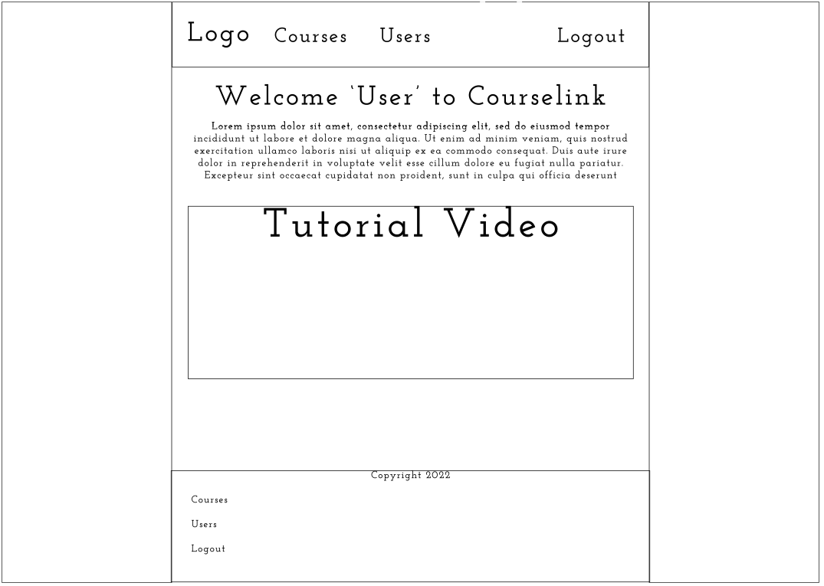
Navbar with Courselink logo and options for courses and users as this is the admin view
Option to logout
Text explaining how to use the site
User’s name is generated and put on the page
Embedded youtube tutorial
Footer with same functionality as navbar including logout

Slide 3
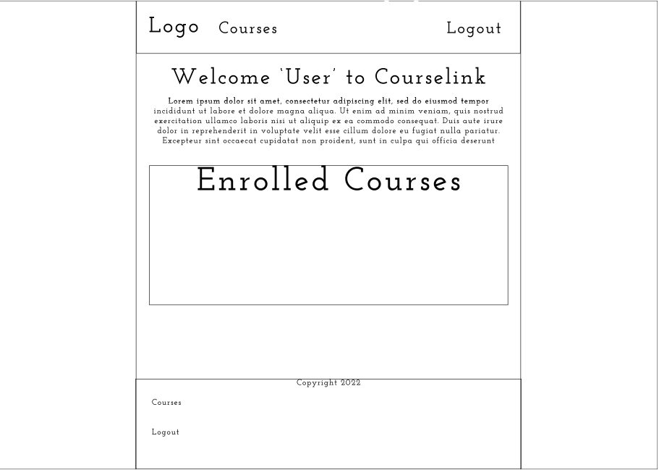
User only sees courses as they can not manage users
User can view and unenroll themselves from a course
Instructions on how to use site will be specific to a user profile
Footer with logout

Slide 4
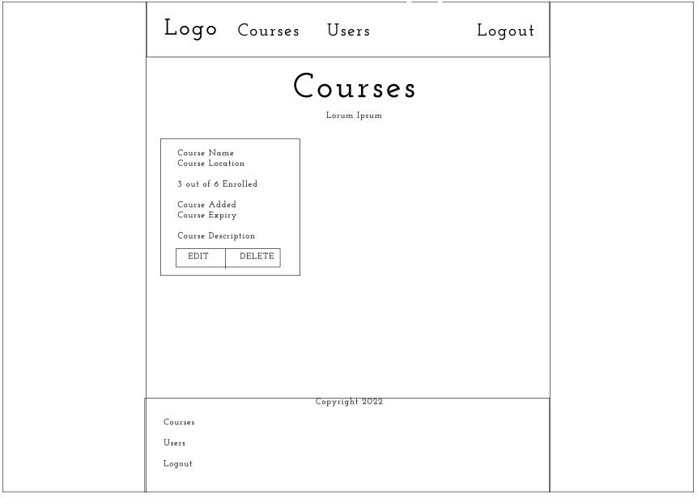
Courses – Admin View
User is an admin so has admin navbar with users/courses
One card for every course there is
Big font so user knows what page they are on.
Course card will contain course name, course location, total enrolled, course added and expiry date as well as course description.
Add Course
Edit and delete course buttons
Option to add course.

Slide 5
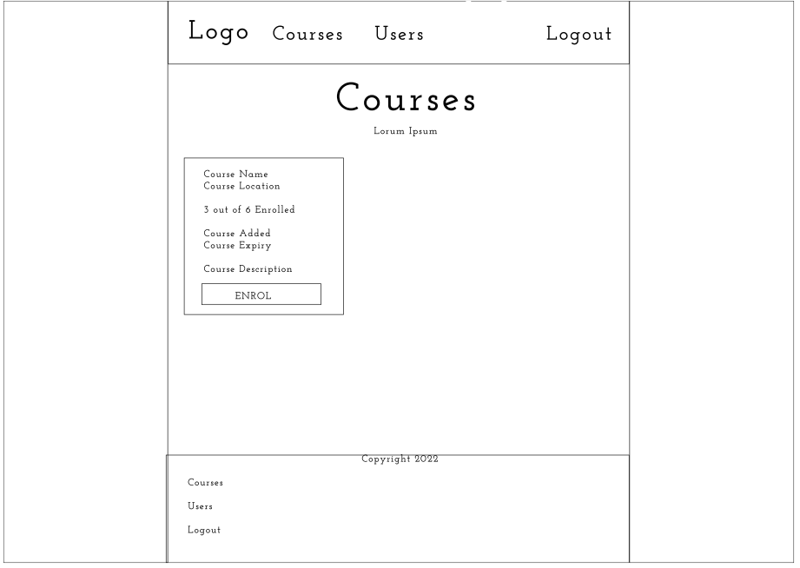
Courses – User View
User can enrol on a course if, it is not full or already enrolled on the course

Slide 6
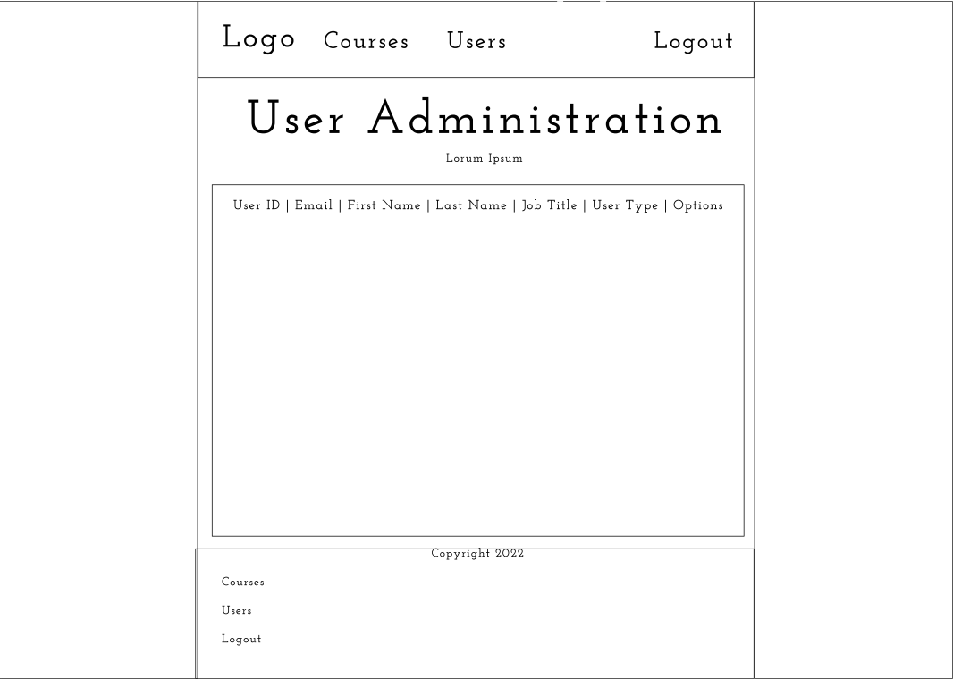
User Admin
Clear heading.
Table which will state user id, first name, last name, job title, user type and options
Options will be editing or deleting a user

